Slide 1

Survey of Polynomial Commitment Schemes
CS797 – MTP Stage I
Presented by: Farhan Jawaid
Guided by: Prof. Sruthi Sekar

Slide 2
Agenda
Background
KZG
Extended: Multilinear KZG
Transparency
Pedersen
Bulletproofs
Dory
Comparison Table
Conclusion & Future Works

Slide 3




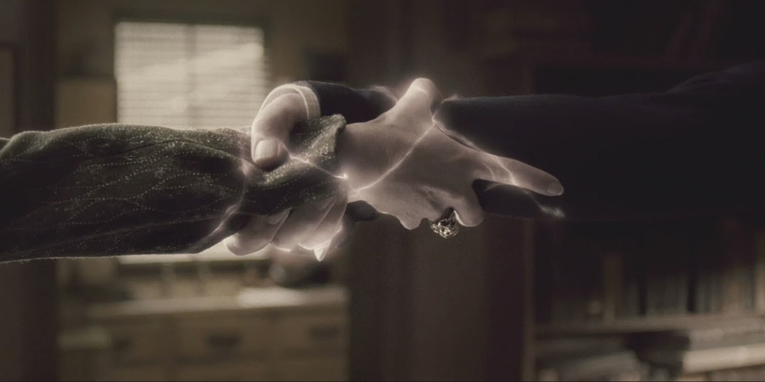





Background (Commitments)
A commitment scheme allows one to commit to a value while keeping it hidden.
Later prove its authenticity or open it to verifier.
Mathematical Form:
C = Commit(m ; r) m=value, r=key
Hiding: Once committed, cant’ be reveal any information about the value.
Binding: Once committed, the value inside can’t be changed.
Prover
Verifier
$$c$$
$$r$$
$$challenge$$
m
$$proof$$
Commitment C

Slide 4

Polynomial Commitment Scheme
Commit to a polynomial once — later prove evaluations without revealing the original polynomial.
Examples: KZG Protocol, Pedersen Protocol, Dory etc…
Arithmetization
Polynomial
Computational Program or DATA
Polynomial Commitment Scheme
Commitment C

Slide 5



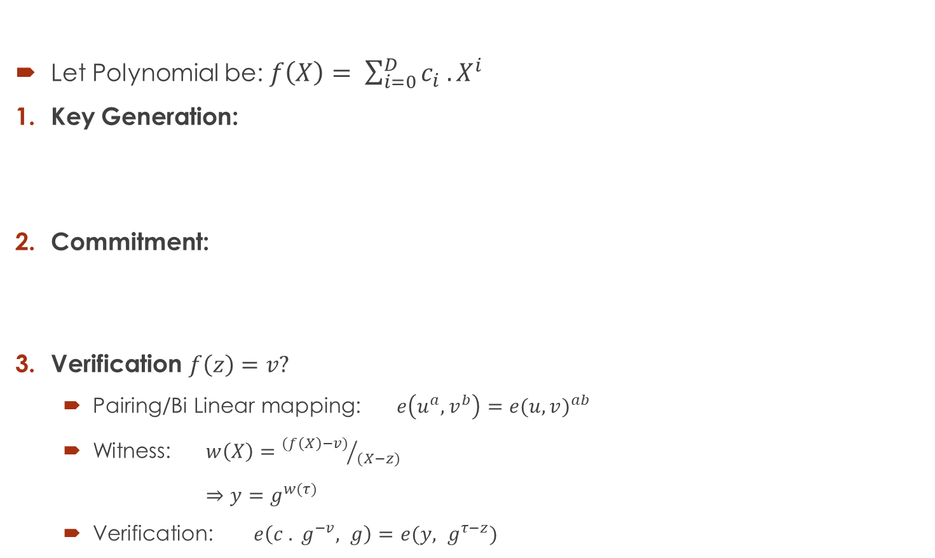


KZG Protocol (Kate–Zaverucha–Goldberg, 2010)
Let Polynomial be: $f\left(X\right)= \sum_{i=0}^{D}{c_{i} . X^{i}}$
Key Generation:
Commitment:
Verification $f\left(z\right)=v?$
Pairing/Bi Linear mapping: $e\left(u^{a}, v^{b}\right)=e{(u, v)}^{ab}$
Witness: $w\left(X\right)={(f\left(X\right)−v)}/{(X−z)}$
⇒ $y=g^{w(τ)}$
Verification: $e\left(c . g^{−v}, g\right)=e(y, g^{τ−z})$
Toxic waste
Key
Prover
Verifier
$$c$$
$$z$$
$$v, y, g^{τ}$$
Only a single message is sent

Slide 6

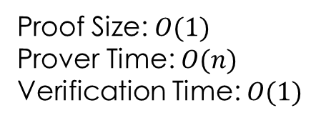
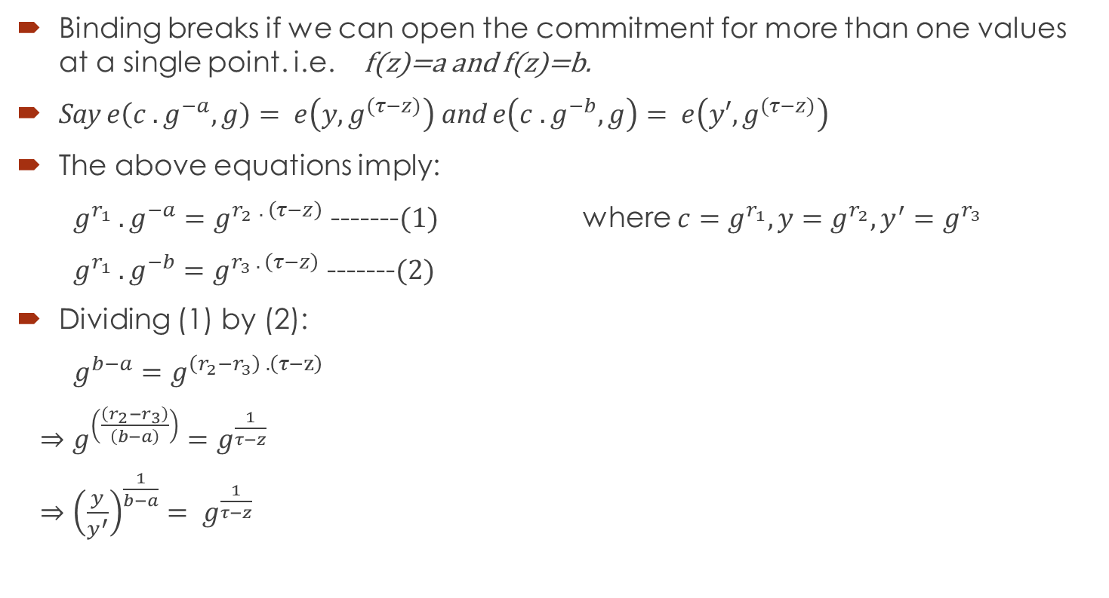
Binding Analysis
Binding breaks if we can open the commitment for more than one values at a single point. i.e. f(z)=a and f(z)=b.
Say $e\left(c . g^{−a}, g\right)= e\left(y, g^{(τ−z)}\right)$ and $e\left(c . g^{−b}, g\right)= e\left(y′, g^{(τ−z)}\right)$
The above equations imply:
$g^{r_{1}} . g^{−a}=g^{r_{2 }. \left(τ−z\right)}$ -------$(1)$ where $c=g^{r_{1}}, y=g^{r_{2}}, y^{′}=g^{r_{3}}$
$g^{r_{1}} . g^{−b}=g^{r_{3} . \left(τ−z\right)}$ -------$(2)$
Dividing (1) by (2):
$g^{b−a}=g^{\left(r_{2}−r_{3}\right) . \left(τ−z\right)}$
⇒ $g^{\left(\frac{\left(r_{2}−r_{3}\right)}{\left(b−a\right)}\right)}=g^{\frac{1}{τ−z}}$
⇒ ${\left(\frac{y}{y^{′}}\right)}^{\frac{1}{b−a}}= g^{\frac{1}{τ−z}}$
Cost:
Proof Size: $O(1)$
Prover Time: $O(n)$
Verification Time: $O(1)$
SDH Broken

Slide 7



Multilinear KZG
KZG works for univariate polynomials (one variable).
Many SNARK constructions use multilinear polynomials $f\left(x_{1},x_{2},…, x_{l}\right)$
Key Generation:
Commitment:
Verification $f\left(z\right)=v?$
Same way as in Univariate KZG
Witness:
SRS=
= Lagrange Polynomial
Basis
Toxic waste
⇒

Slide 8



Multilinear KZG Contd…
Divide the above equation by ${(X}_{i}−z_{i})$ to get $w_{i}(X)$.
Until:
⇒ $y_{i}=g^{w_{i}}$
Verification:
Binding Analysis?
Same as Univariate
Cost:
Proof Size: o($ℓ$)
Prover Time: O($2^{ℓ}$)
Verification Time: O($ℓ$)

Slide 9
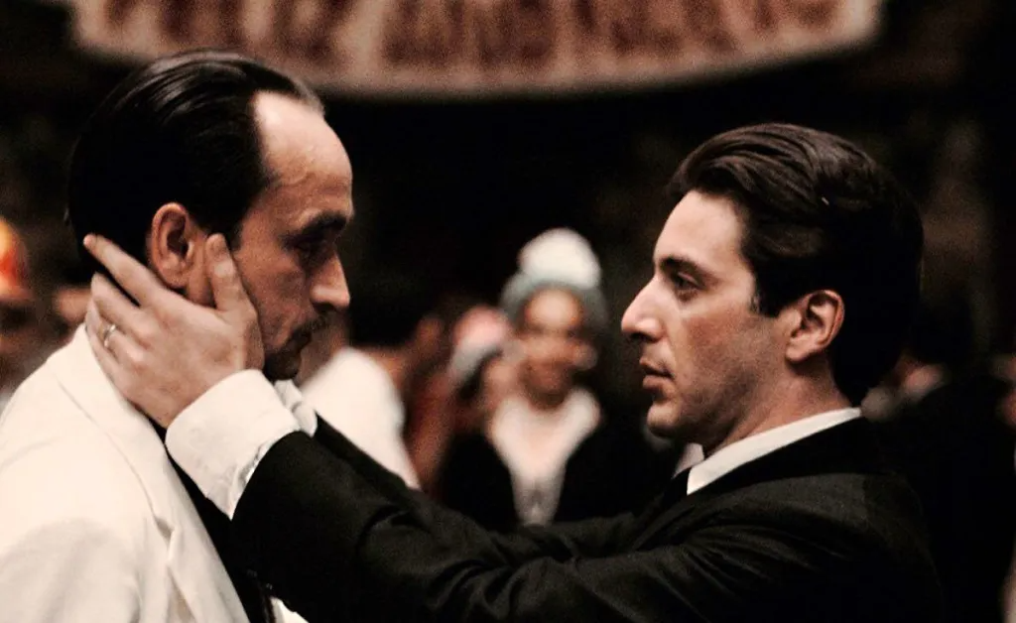
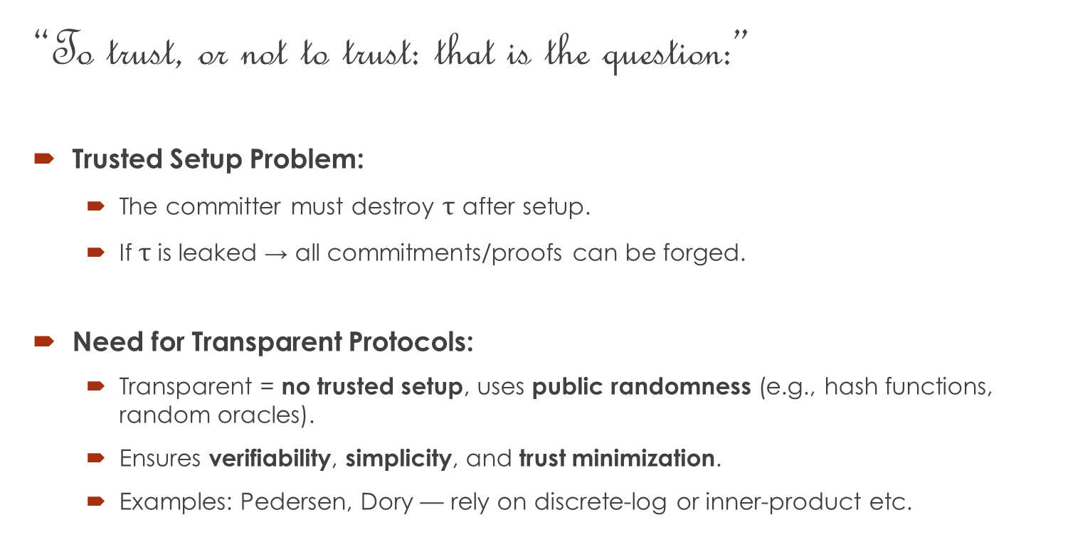
Transparency
“To trust, or not to trust: that is the question:”
Trusted Setup Problem:
The committer must destroy $τ$ after setup.
If $τ$ is leaked → all commitments/proofs can be forged.
Need for Transparent Protocols:
Transparent = no trusted setup, uses public randomness (e.g., hash functions, random oracles).
Ensures verifiability, simplicity, and trust minimization.
Examples: Pedersen, Dory — rely on discrete-log or inner-product etc.

Slide 10
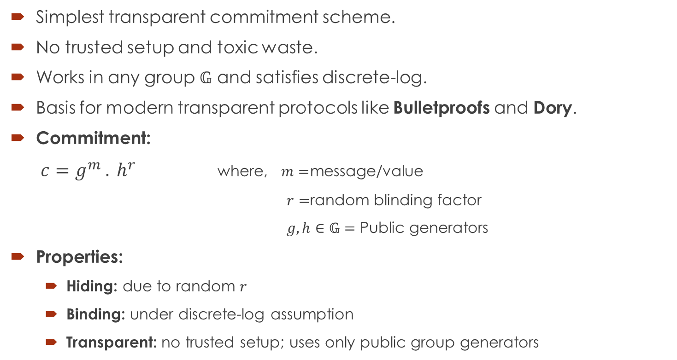
Pedersen Protocol (Torben Pedersen, 1991)
Simplest transparent commitment scheme.
No trusted setup and toxic waste.
Works in any group $𝔾$ and satisfies discrete-log.
Basis for modern transparent protocols like Bulletproofs and Dory.
Commitment:
$c=g^{m} . h^{r}$ where, $m=$message/value
$r=$random blinding factor
$g, h∈𝔾=$ Public generators
Properties:
Hiding: due to random $r$
Binding: under discrete-log assumption
Transparent: no trusted setup; uses only public group generators

Slide 11

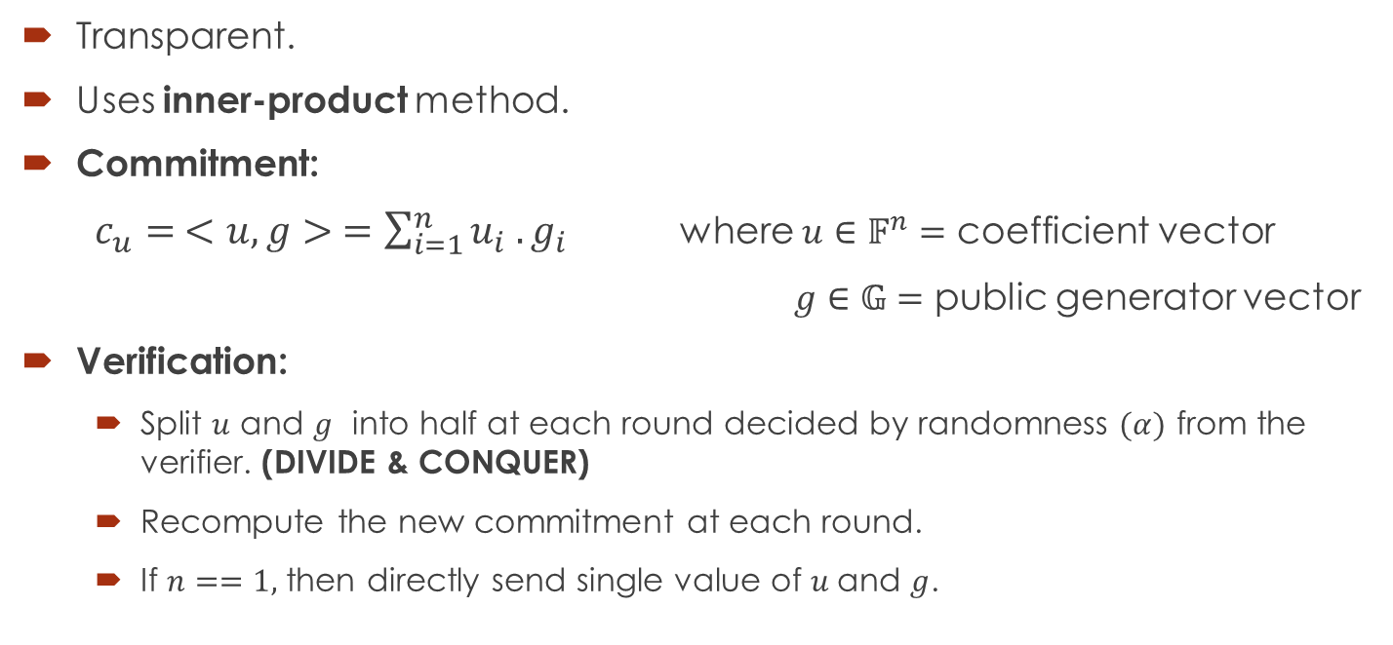
Bulletproofs (Bünz et al., 2018)
Transparent.
Uses inner-product method.
Commitment:
$c_{u}= <u, g> =\sum_{i=1}^{n}{u_{i} . g_{i}}$ where $u∈𝔽^{n}=$ coefficient vector
$g∈𝔾=$ public generator vector
Verification:
Split $u$ and $g$ into half at each round decided by randomness $(α)$ from the verifier. (DIVIDE & CONQUER)
Recompute the new commitment at each round.
If $n==1,$ then directly send single value of $u$and $g$.

Slide 12




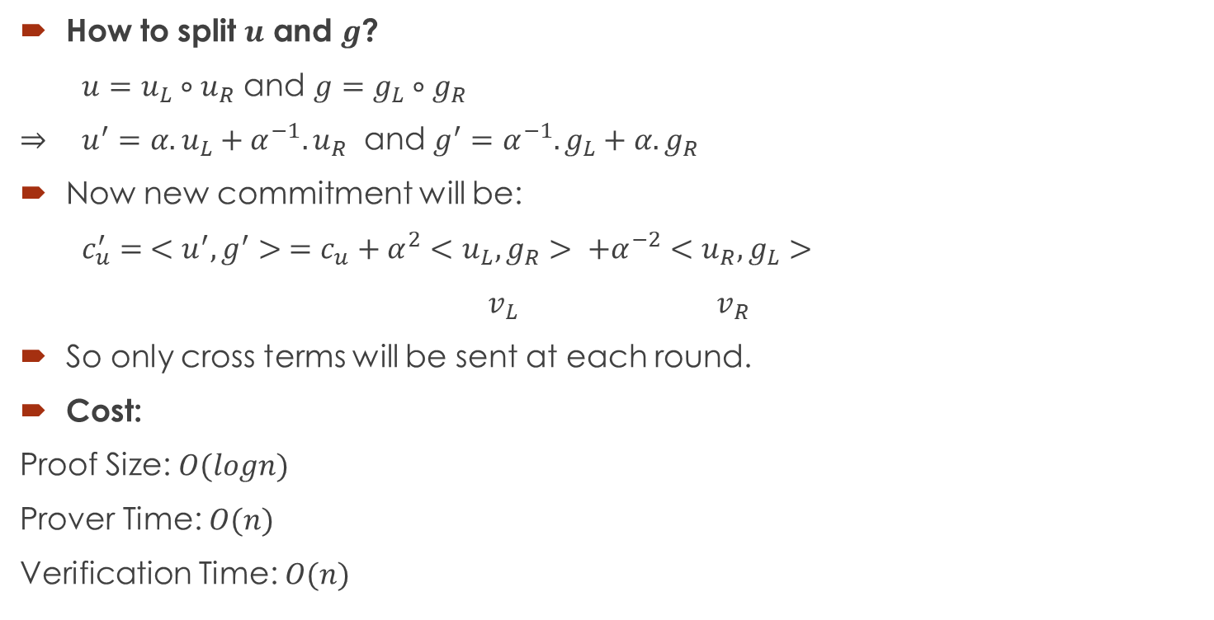






Bulletproofs Contd…
How to split $u$ and $g$?
$u=u_{L}∘u_{R}$ and $g=g_{L}∘g_{R}$
⇒ $u^{′}=α.u_{L}+α^{−1}.u_{R}$ and $g^{′}=α^{−1}.g_{L}+α.g_{R}$
Now new commitment will be:
$c_{u}^{′}= <u^{′}, g^{′}> =c_{u}+α^{2}<u_{L}, g_{R}> +α^{−2}<u_{R}, g_{L}>$
$v_{L}$ $v_{R}$
So only cross terms will be sent at each round.
Cost:
Proof Size: $O(logn)$
Prover Time: $O(n)$
Verification Time: $O(n)$
Cross Terms
Prover
Verifier
$$c_{u}$$
$$u^{′}, g′$$
$$α_{1}$$
$$g′$$
$$v_{L}, v_{R}$$
$$c_{u}^{′}$$
.
.
.
$$c_{u}^{′}$$
Single element
$$\overline{u}, \overline{g}$$
$$c_{u}^{\left(logn\right)}=?\overline{u} . \overline{ g}$$
$$g^{\left(logn\right)}=?\overline{g}$$

Slide 13
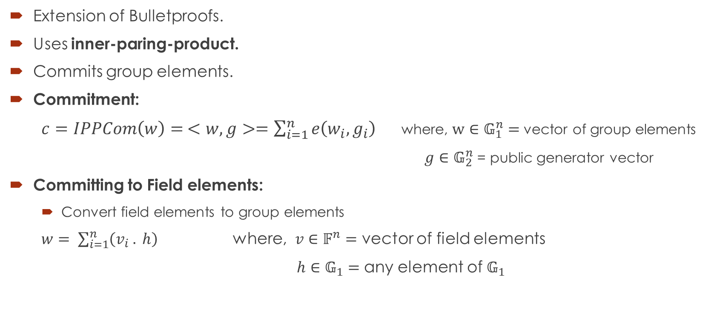
Dory (Chase et al., 2021)
Extension of Bulletproofs.
Uses inner-paring-product.
Commits group elements.
Commitment:
$c=IPPCom\left(w\right)= <w, g>=\sum_{i=1}^{n}{e\left(w_{i}, g_{i}\right)}$ where, $w∈𝔾_{1}^{n}=$ vector of group elements
$g∈𝔾_{2}^{n}$ = public generator vector
Committing to Field elements:
Convert field elements to group elements
$w= \sum_{i=1}^{n}{\left(v_{i} . h\right)}$ where, $v∈𝔽^{n}=$ vector of field elements
$h∈𝔾_{1}=$ any element of $𝔾_{1}$

Slide 14
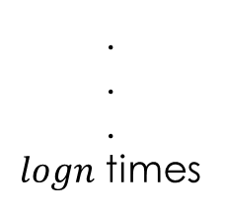
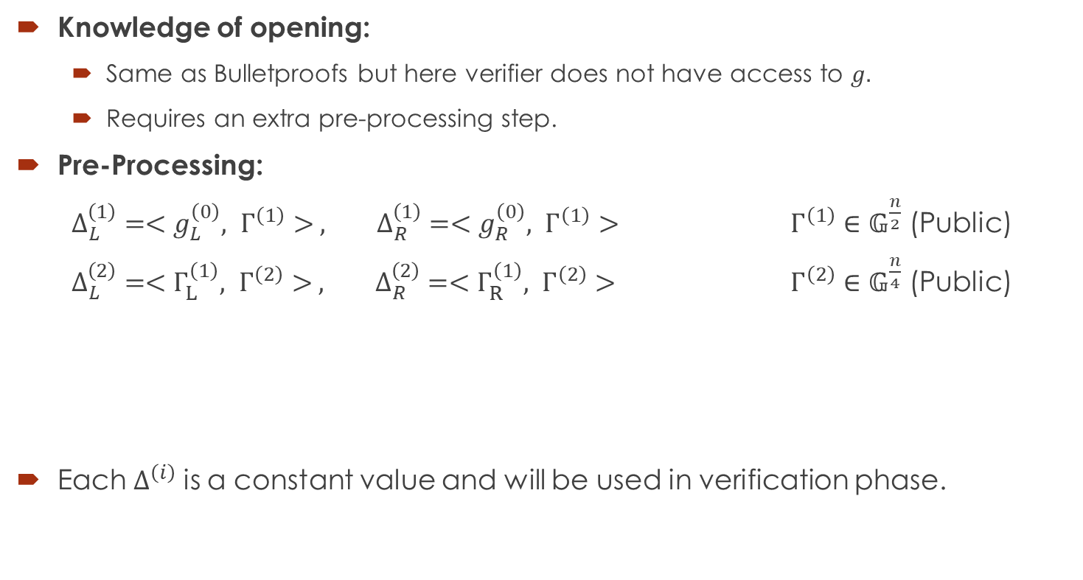
Dory Contd…
Knowledge of opening:
Same as Bulletproofs but here verifier does not have access to $g.$
Requires an extra pre-processing step.
Pre-Processing:
$Δ_{L}^{\left(1\right)}=<g_{L}^{\left(0\right)}, Γ^{\left(1\right)}> , Δ_{R}^{\left(1\right)}=<g_{R}^{\left(0\right)}, Γ^{\left(1\right)}>$ $Γ^{\left(1\right)}∈𝔾^{\frac{n}{2}}$ (Public)
$Δ_{L}^{\left(2\right)}=<Γ_{L}^{\left(1\right)}, Γ^{\left(2\right)}> , Δ_{R}^{\left(2\right)}=<Γ_{R}^{\left(1\right)}, Γ^{\left(2\right)}>$ $Γ^{\left(2\right)}∈𝔾^{\frac{n}{4}}$ (Public)
Each $Δ^{\left(i\right)}$ is a constant value and will be used in verification phase.
.
.
.
$logn$ times

Slide 15
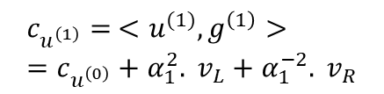














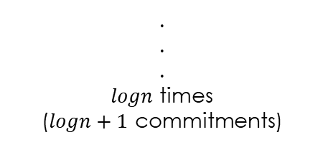



$$c_{u}^{′}= <u^{′}, g^{′}> =c_{u}+α^{2}. v_{L}+α^{−2}. v_{R}$$
Verification:
Prover
Verifier
$$c_{u^{\left(0\right)}}$$
$$α_{1}$$
$$c_{u^{\left(1\right)}}= <u^{(1)}, g^{\left(1\right)}> =c_{u^{\left(0\right)}}+α_{1}^{2}. v_{L}+α_{1}^{−2}. v_{R}$$
$$u^{\left(1\right)}, g^{\left(1\right)}, v_{L}, v_{R}$$
$$v_{L}, v_{R}$$
$$c_{g^{\left(1\right)}}= <g^{\left(1\right)}, Γ^{\left(1\right)}> =α_{1}^{−1}. Δ_{L}^{\left(1\right)}+α_{1} . Δ_{R}^{\left(1\right)}$$
Round1: 2 Commitments
$$α_{2}$$
$$u^{\left(2\right)}, g^{\left(2\right)}, v_{L}, v_{R}$$
$$c_{u^{\left(2\right)}}$$
$$w_{L}=<g_{L}^{\left(1\right)}, Γ_{R}^{\left(1\right)}>$$
$$v_{L}, v_{R}, w_{L}, w_{R}$$
$$c_{g^{\left(2\right)}}=c_{g^{\left(1\right)}}+α^{2}. w_{L}+α^{−2}. w_{R}$$
$$w_{R}=<g_{R}^{\left(1\right)}, Γ_{L}^{\left(1\right)}>$$
Round2: 3 Commitments
.
.
.
$logn$ times
($logn+1$ commitments)
$$c_{Γ^{\left(1\right)}}^{\left(2\right)}=α_{2}^{−1}. Δ_{L}^{\left(2\right)}+α_{2} . Δ_{R}^{\left(2\right)}$$
$$c_{u^{\left(logn\right)}}=?<\overline{u },\overline{g}>$$
$$\overline{u,} \overline{g}, \overline{Γ^{\left(1\right)}}, \overline{Γ^{\left(2\right)}}, …$$
$$c_{g^{\left(logn\right)}}=?<\overline{g} , \overline{Γ^{\left(1\right)}}>$$
Chaining
All single elements
$$c_{Γ^{\left(1\right)}}^{\left(logn\right)}=?<\overline{Γ^{\left(1\right)}} , \overline{Γ^{\left(2\right)}}>$$
.
.
.

Slide 16
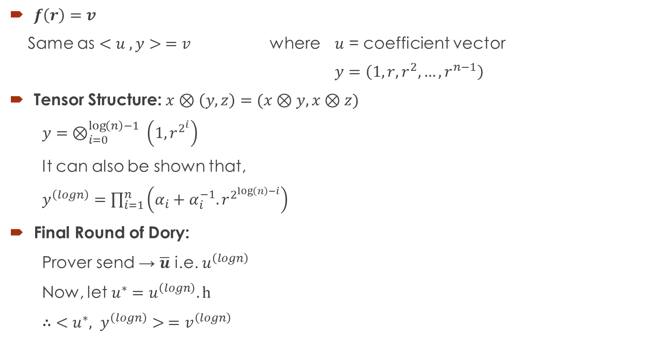
Evaluation
$f\left(r\right)=v$
Same as $<u , y> =v$ where $u$ = coefficient vector
$y=\left(1,r,r^{2},…, r^{n−1}\right)$
Tensor Structure: $x⊗\left(y, z\right)=(x⊗y, x⊗z)$
$y= ⊗_{i=0}^{\log\left(n\right)−1} \left(1, r^{2^{i}}\right)$
It can also be shown that,
$y^{\left(logn\right)}=\prod_{i=1}^{n}{\left(α_{i}+α_{i}^{−1}. r^{2^{\log\left(n\right)−i}}\right)}$
Final Round of Dory:
Prover send → $\overline{u}$ i.e. $u^{\left(logn\right)}$
Now, let $u^{∗}=u^{\left(logn\right)}.h$
∴ $<u^{∗}, y^{\left(logn\right)}> =v^{\left(logn\right)}$

Slide 17

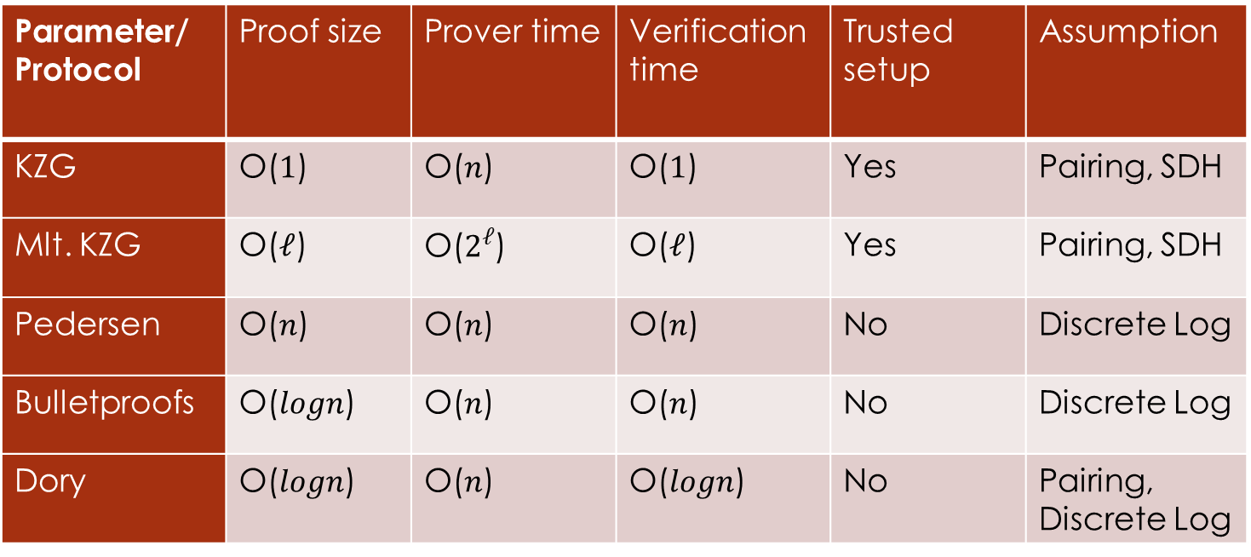
Comparison Table
Parameter/ Protocol | Proof size | Prover time | Verification time | Trusted setup | Assumption
KZG | O($1$) | O($n$) | O($1$) | Yes | Pairing, SDH
Mlt. KZG | O($ℓ$) | O($2^{ℓ}$) | O($ℓ$) | Yes | Pairing, SDH
Pedersen | O($n$) | O($n$) | O($n$) | No | Discrete Log
Bulletproofs | O($logn$) | O($n$) | O($n$) | No | Discrete Log
Dory | O($logn$) | O($n$) | O($logn$) | No | Pairing, Discrete Log
Non Transparent
Transparent

Slide 18
Conclusion
Non-Transparent (Trusted Setup)
Pros: Extremely efficient, constant proof size
Cons: Requires SRS — introduces toxic waste risk
Transparent (No Trusted Setup)
Pros: No trust assumption, publicly verifiable randomness
Cons: Larger proofs, slower verification compared to Non Transparent
Trade-off: Efficiency ↔ Transparency
Choice depends on use-case and trust model
Future Works:
Study the Samaritan Protocol
Implementation-based Research:
Develop and test commitment protocol implementations using Rust
Benchmark prover/verification time, proof size, and memory use
Compare transparent vs non-transparent schemes in real-world settings

Slide 19
Thank You

